Slide 1

Home automation using android devices
Domain : artificial intelligence & machine learning

Slide 2
Aim
The main objective of Smart Home Automation is to improve the quality of life and convenience in the home. There are other goals such as Greater Security and more Efficient use of Energy.
In Home Automation, household activities are controlled by android devices, we use in daily life such as android smartphone, smartwatch, tablets etc. with this we could operate home appliances with one click! Making life easier specially for physically challenged people and senior citizens.

Slide 3
Hardware requirement
Solderless Breadboard
Arduino Nano
HC-05 Bluetooth Module
4-Channel 5v Relay Module
Male to Female jumper Wires
Bulb Holder x 2
220v LED Bulb x 2
AC Fan 220v
5v 2Amp Power Adapter

Slide 4
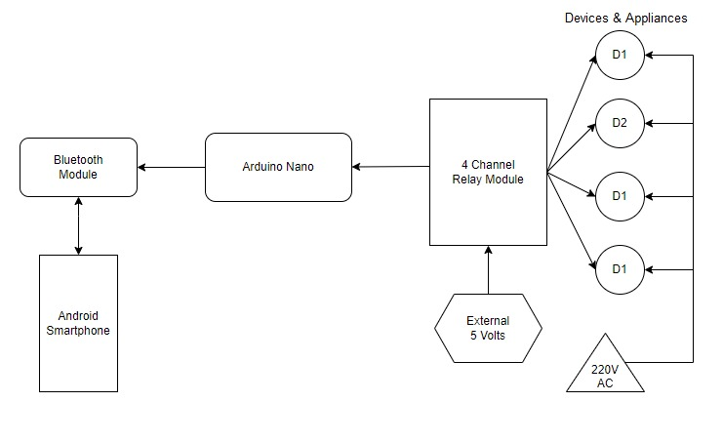
Block diagram

Slide 5
Software requirement
ARDUINO IDE
The Arduino Integrated Development Environment (IDE) is a cross-platform application
(for Windows, macOS, Linux) that is written in functions from C and C++. It is used to write
and upload programs to Arduino compatible boards, but also, with the help of third-party
cores, other vendor development boards.
Any one familiar with C or C++ would be able to write Arduino programs without any
difficulty. This makes Arduino IDE suitable for our project. It can be easily download and
installed from www.arduino.cc .

Slide 6
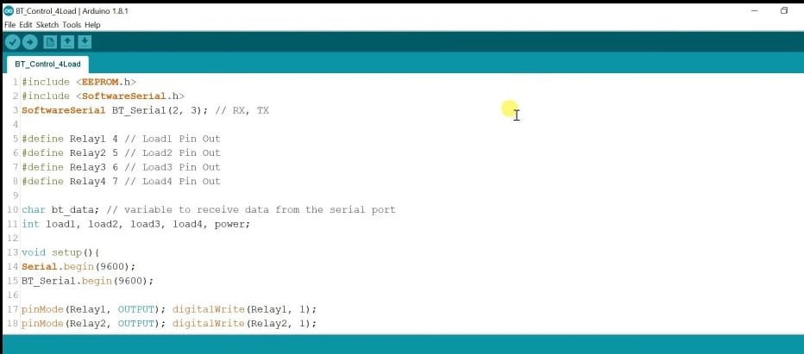
ARDUINO IDE UI

Slide 7
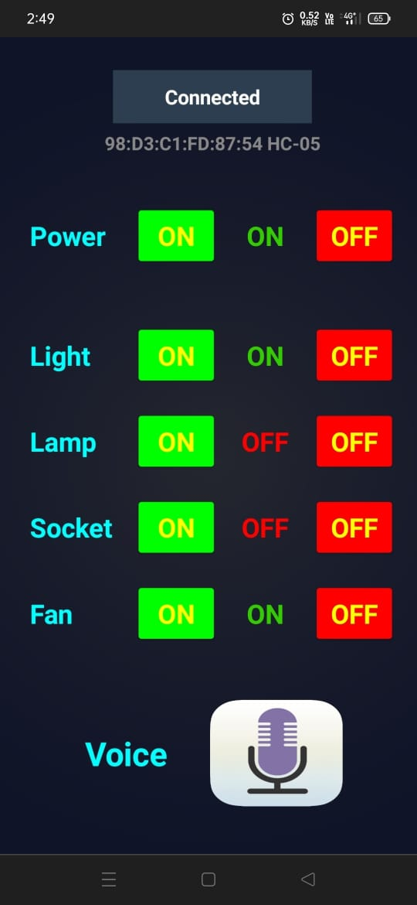
MIT APP Inventor FOR ANDRIOD
MIT APP Inventor is web application integrated development environment originally provided by Google. Any one can build apps with global Impact. https://appinventor.mit.edu
APPLICATION GRAPICS

Slide 8
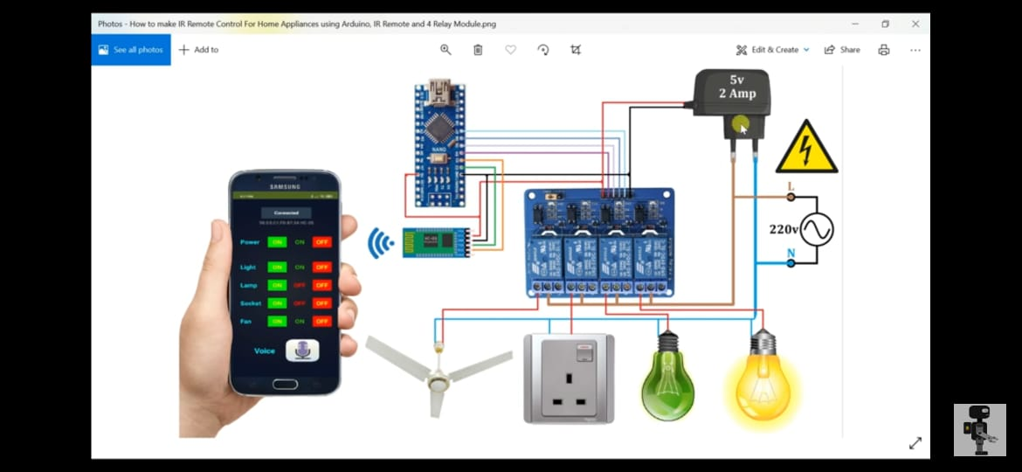
Circuit diagram

